Slide 1
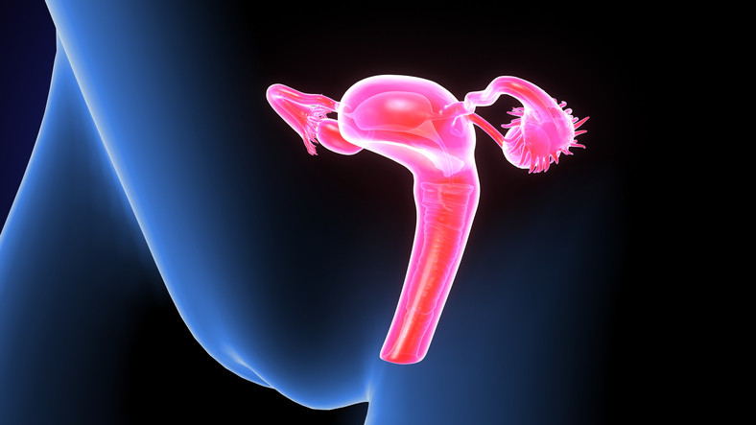
DESCRITIVE ANALYTICS APPROACH TO STUDY CERVICAL CANCER PATIENTS
Sucharitha Batchu (10433918)
BIA 686
Prof: Christopher Asakiewicz
Stevens Institute of Technology

Slide 2
Introduction
Cervical cancer occurs when abnormal cells on the cervix grow out of control.
Cervical cancer is most often caused by a virus called human papillomavirus, or HPV which is contracted by having sexual contact with someone who has it
It should also be noted though, that not all types of HPV cause cervical cancer
An early diagnosis of cervical problems will help to increase the patient’s survival rate

Slide 3
Data and Pattern Discovery
Pattern discovery is discovery of interesting and unexpected structures in large data sets
Accomplishments from pattern discovery in this study:
About 11,000 new cases of invasive cervical cancer are diagnosed each year in the U.S and each year cervical cancer kills about 4,000 women in the U.S. and about 300,000 women worldwide. This study can predict the cervical cancer patients and helps in prevention/early cure
Obtained tha data from https://www.kaggle.com/loveall/cervical-cancer-risk-classification which was collected at 'Hospital Universitario de Caracas' in Caracas, Venezuela.

Slide 4
Data Set
Data set details:
858 cervical patient records.
36 attributes with 35 independent attributes and target attribute.
16 of 36 attributes will be used for modeling which are explained later in the slides.
Dx: Cancer is the target variable which says if the patients has cervical cancer or not.

Slide 5
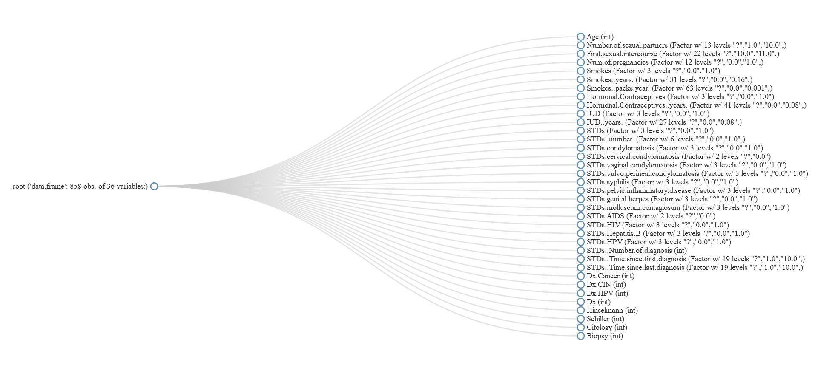
Data Set (continued)

Slide 6
Data Preparation
Attribute Details
1. Age: Integer
2. Number of sexual partners: Integer
3. First sexual intercourse: Mentions the age at which the patient first had sexual intercourse. Integer.
4. Number of pregnancies: Integer
5. Smokes: 1 or 0. Boolean.
6. Smokes (Years): Number of years the patient is smoking since. Numeric.
7. Smokes (Packs/Year): Number of packs the patient smokes per year. Numeric.
8. Hormonal Contraceptives: 1 or 0. Boolean.
9. Hormonal Contraceptives (Years): Numeric
10. Sexually Transmitted Diseases (STDs): 1 or 0. Boolean.
11. Sexually Transmitted Diseases (STDs) (Years): Numeric.
12. STDs (AIDS): 1 or 0. Boolean.
13. STDs (HIV): 1 or 0. Boolean.
14. STDs (Hepatitis B): 1 or 0. Boolean.
15. STDs (HPV): 1 or 0. Boolean.
16. Dx (Cancer): This is the target variable and contains values 1 or 0. Boolean

Slide 7
Data Preparation
the Data preparation phase, we need to do the following
Clean the data
Transform the data
We review the data for the following
Identify missing values and replace them
Deal with outliers if any
Find and deal with attribute that need transformation
Choose the appropriate attributes for the analysis

Slide 8
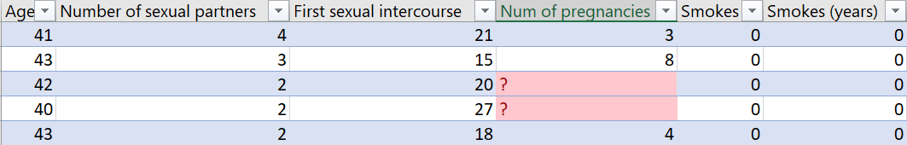
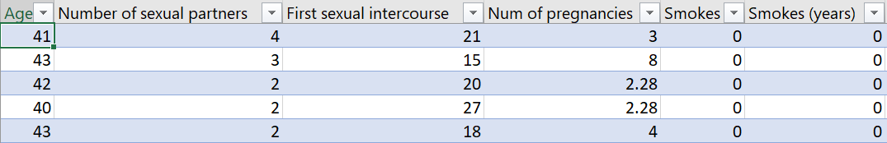
Data Preparation (continued)
Dealing with missing values
There are a few missing values in the dataset. For example the pregnancy column
We replace the missing values by the mean of remaining values

Slide 9
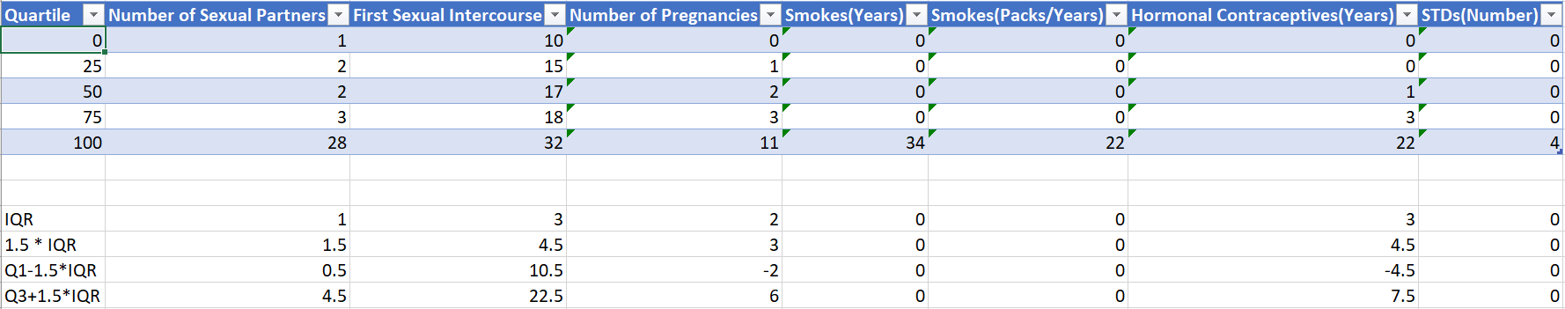
Data Preparation (continued)
Identifying and dealing with Outliers:
An outlier is an observation that lies an abnormal distance from other values in a random sample from a population
We identify these outliers by calculating the IQR(Inter Quartile Range) and remove them

Slide 10
Data Preparation (continued)
Selecting relevant attributes for analysis:
As mentioned previously, our data set consists of 36 attributes
16 attributes seems to play a role in identifying if a patient has cervical cancer or not.
We choose only these attributes.

Slide 11
Final Populated Data
Cleaned and transformed data
The previously shown data set consisting of 858 records
After removing records containing outliers and handling missing values we will be left with 435 records
Data Divided into Training and Testing which is 80% and 20% respectively
Model is developed using training data which are 349 records
Model is evaluated using testing data which are 86 records

Slide 12
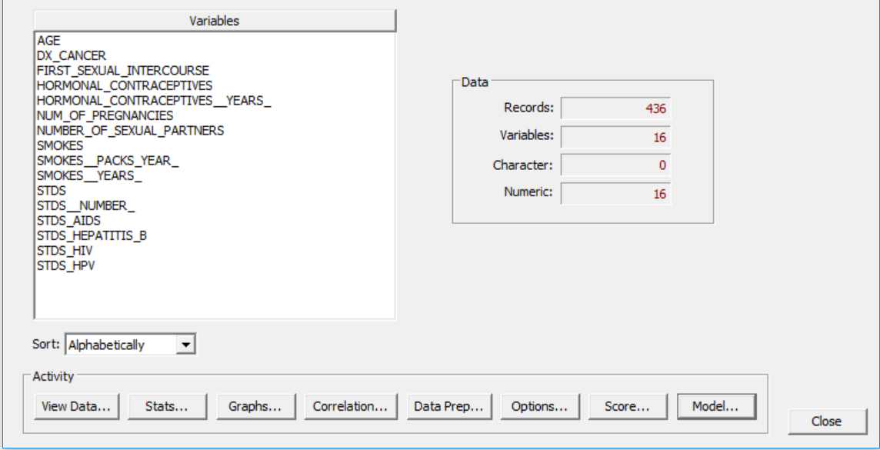
Modeling
Our goal is to understand the pattern that matches the data to classify patients into yes or no for cervical cancer and using the data and derive rules to construct the relationship between the variables and the target variable.
Software used : CART® software provided by Salford Predictive Miner

Slide 13
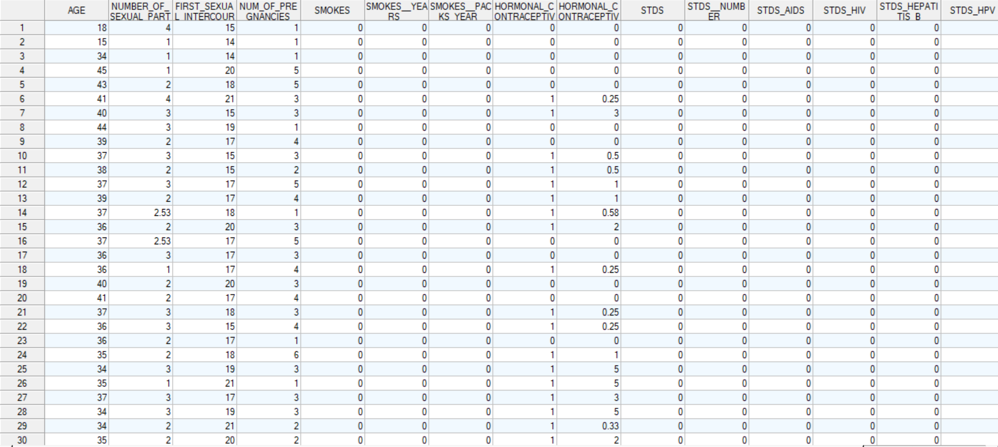
Analysis
Viewing the data file:

Slide 14
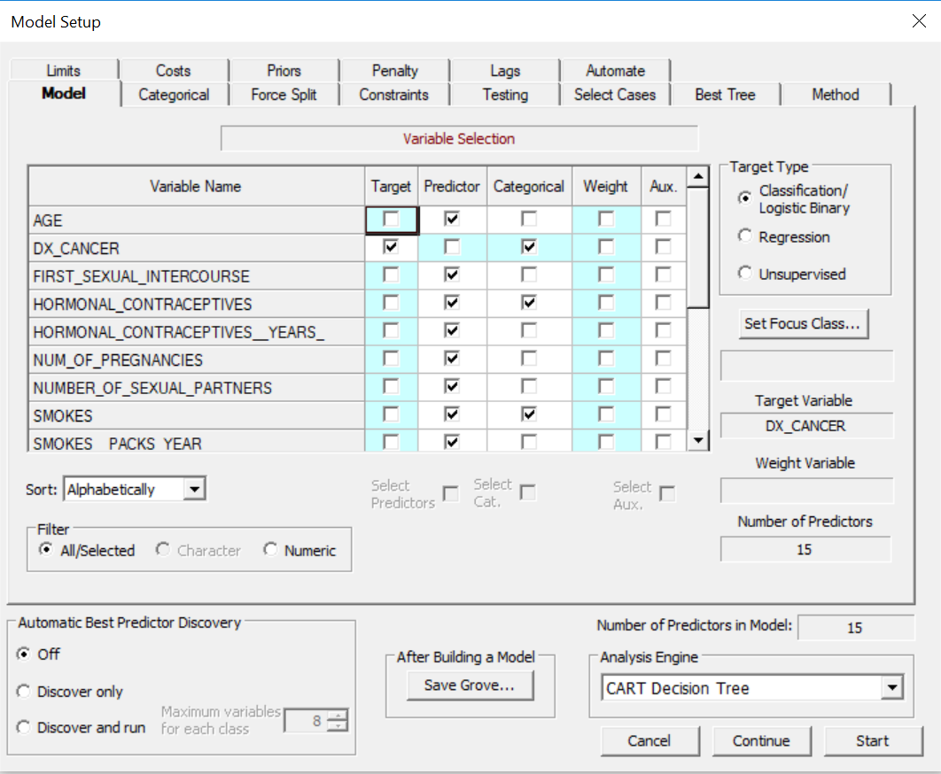
Execution Using CART®
Set the model we first select the target variable and the predictor variables
To begin CART analysis just click on start.
Decision trees are generated once the analysis is performed.

Slide 15
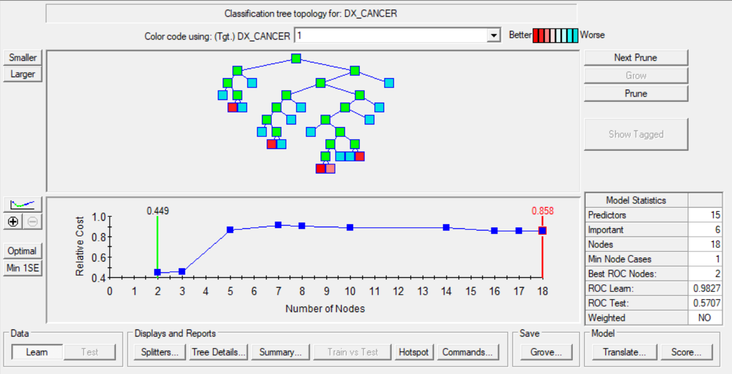
Summary Statistics
Classification tree topology for target variable
Here is the snippet of the optimal tree
This optimal tree has the best performance which is displayed in the lower panel of the navigator
There are 18 nodes in the tree

Slide 16
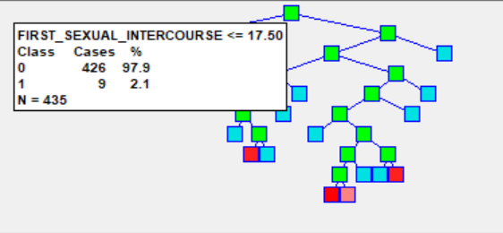
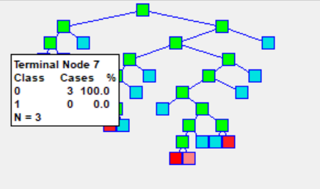
Summary Statistics (Continued)
Viewing node details
Figure on the top represents the details of the root node: Viewing the details, we note that we started with 426 non-cervical patients (0’s) and 9 cervical patients (1’s), the first split occurred for attribute FIRST_SEXUAL_INTERCOURSE.
Figure on the bottom represents the details of one of the terminal nodes: This node has a non-cervical patient rate of 100% and has a node population of 3.

Slide 17
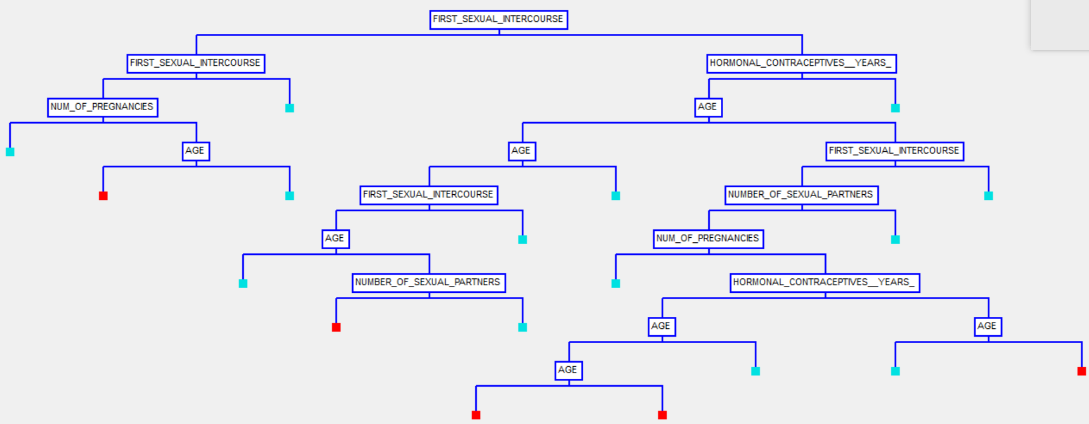
Summary Statistics (Continued)
Viewing the main splitters
This view highlights the attributes that were used at each level for splitting.
Color coding is done to simplify the understanding
Red indicating cervical patients
Blue indicating non cervical patients

Slide 18
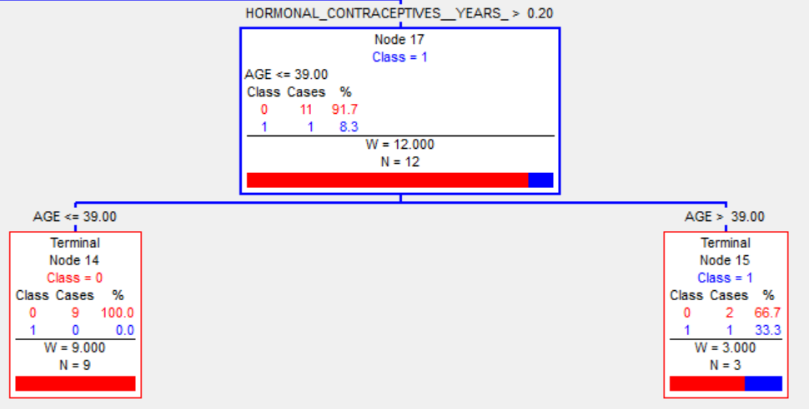
Summary Statistics (Continued)
Exploring sub trees
The figure on the right represents sub tree for Node 17. As we see the split for this node occurs on attribute “AGE” which finally result in 2 terminal nodes.
Terminal node 14 consisting of non-cervical
Terminal node 15 which holds both non-cervical and cervical patients.

Slide 19
Summary Statistics (Continued
Decision Rules
Antecedent | Consequent
FIRST_SEXUAL_INTERCOURSE <= 17.5 && FIRST_SEXUAL_INTERCOURSE > 14.5 | Non cervical patient
FIRST_SEXUAL_INTERCOURSE <= 14.5 && NUM_OF_PREGNANCIES <= 2.64 | Non cervical patient
FIRST_SEXUAL_INTERCOURSE <= 14.5 && NUM_OF_PREGNANCIES > 2.64 && AGE <= 28 | Cervical patient
FIRST_SEXUAL_INTERCOURSE <= 14.5 && NUM_OF_PREGNANCIES > 2.64 && AGE > 28 | Non cervical patient
FIRST_SEXUAL_INTERCOURSE > 17.5 && HORMONAL_CONTRACEPTIVE_YEARS > 1.50 | Non cervical patient
FIRST_SEXUAL_INTERCOURSE > 17.5 && FIRST_SEXUAL_INTERCOURSE <= 18.5 && HORMONAL_CONTRACEPTIVE_YEARS <= 1.50 && AGE <= 18.50 | Non cervical patient
FIRST_SEXUAL_INTERCOURSE > 17.5 && HORMONAL_CONTRACEPTIVE_YEARS <= 1.50 && AGE <= 28.5 && AGE > 21.5 | Cervical patient
FIRST_SEXUAL_INTERCOURSE > 18.5 && HORMONAL_CONTRACEPTIVE_YEARS <= 1.50 && AGE <= 21.5 | Non cervical patient

Slide 20
Modeling(Set of Decision Rules Continued)
Antecedent | Consequent
FIRST_SEXUAL_INTERCOURSE > 17.5 && HORMONAL_CONTRACEPTIVE_YEARS <= 1.50 && AGE <= 21.5 && FIRST_SEXUAL_INTERCOURSE <= 18.5 && AGE > 18.5 && NUM_OF_SEXUAL_PARTNERS <= 2.50 | Cervical patient
FIRST_SEXUAL_INTERCOURSE > 17.5 && HORMONAL_CONTRACEPTIVE_YEARS <= 1.50 && AGE <= 21.5 && FIRST_SEXUAL_INTERCOURSE <= 18.5 && AGE > 18.5 && NUM_OF_SEXUAL_PARTNERS > 2.50 | Non cervical patient
FIRST_SEXUAL_INTERCOURSE > 20.5 && HORMONAL_CONTRACEPTIVE_YEARS <= 1.50 && AGE > 28.5 | Non cervical patient
FIRST_SEXUAL_INTERCOURSE > 17.5 && HORMONAL_CONTRACEPTIVE_YEARS <= 1.50 && AGE > 28.5 && FIRST_SEXUAL_INTERCOURSE <= 20.5 && NUM_OF_SEXUAL_PARTNERS > 3.50 | Cervical patient
FIRST_SEXUAL_INTERCOURSE > 17.5 && HORMONAL_CONTRACEPTIVE_YEARS <= 1.50 && AGE > 28.5 && FIRST_SEXUAL_INTERCOURSE <= 20.5 && NUM_OF_SEXUAL_PARTNERS <= 3.50 && NUM_OF_PREGNANCIES <= 0.50 | Non cervical patient
FIRST_SEXUAL_INTERCOURSE > 17.5 && HORMONAL_CONTRACEPTIVE_YEARS <= 0.20 && AGE > 48.5 && FIRST_SEXUAL_INTERCOURSE <= 20.5 && NUM_OF_SEXUAL_PARTNERS <= 3.50 && NUM_OF_PREGNANCIES > 0.50 | Non cervical patient
FIRST_SEXUAL_INTERCOURSE > 17.5 && HORMONAL_CONTRACEPTIVE_YEARS <= 0.20 && AGE > 28.5 && AGE <= 35 && FIRST_SEXUAL_INTERCOURSE <= 20.5 && NUM_OF_SEXUAL_PARTNERS <= 3.50 && NUM_OF_PREGNANCIES > 0.50 | Cervical patient
FIRST_SEXUAL_INTERCOURSE > 17.5 && HORMONAL_CONTRACEPTIVE_YEARS <= 0.20 && AGE > 35 && AGE <= 48.5 && FIRST_SEXUAL_INTERCOURSE <= 20.5 && NUM_OF_SEXUAL_PARTNERS <= 3.50 && NUM_OF_PREGNANCIES > 0.50 | Non cervical patient

Slide 21
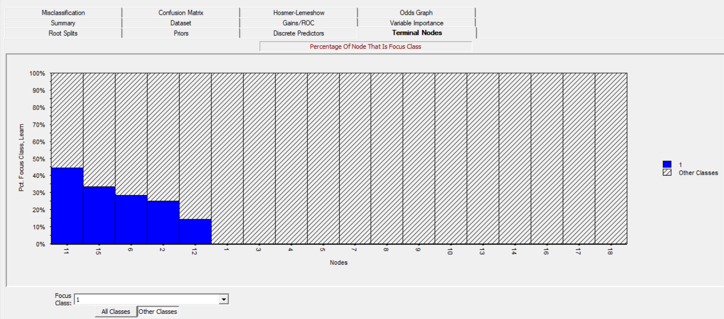
Summary Statistics (Continued)
Terminal Nodes Report: This report shows the ability of the tree’s terminal nodes to capture the cervical patients.

Slide 22
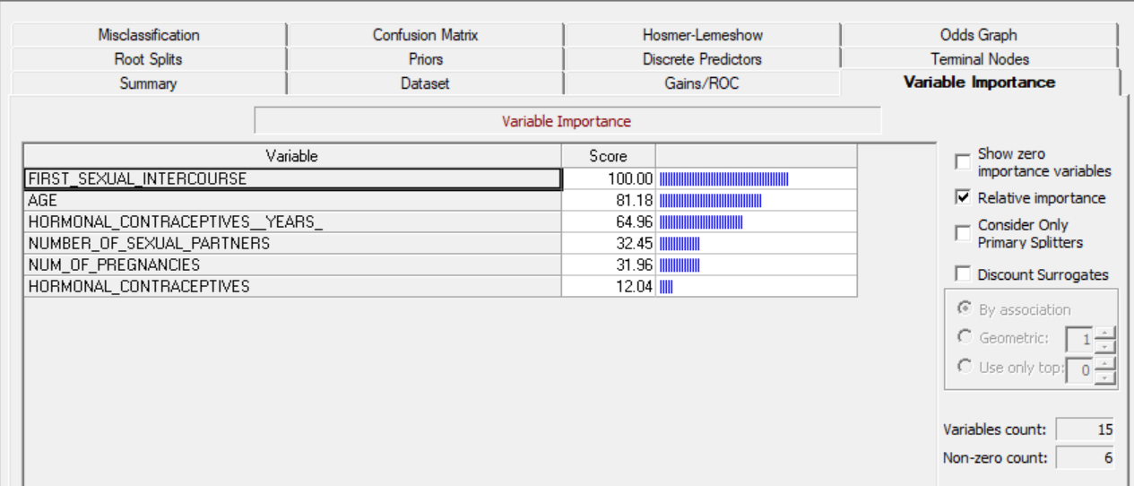
Summary Statistics (Continued)
Variable Importance:

Slide 23
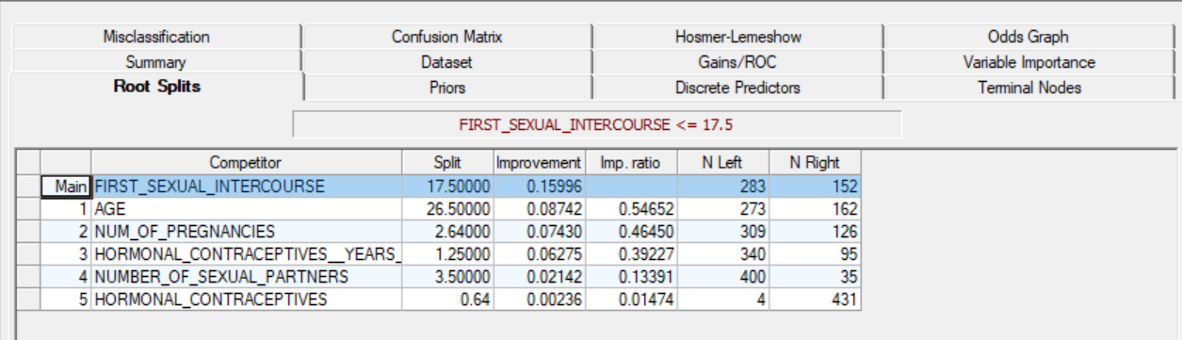
Summary Statistics (Continued)
Root Splits: The root splits lists all root node competitors sorted in descending order. It also displays split details in terms of case count.

Slide 24
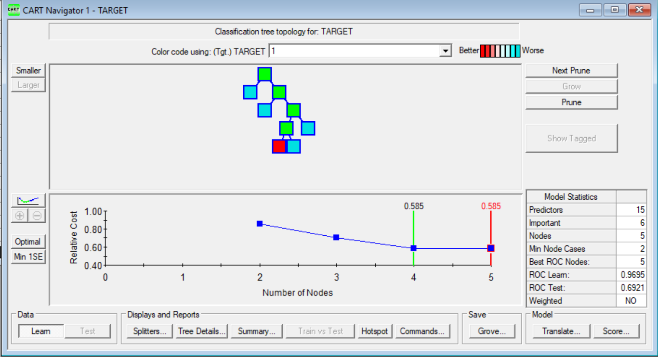
Summary Statistics (Continued)
Testing the model on test data

Slide 25
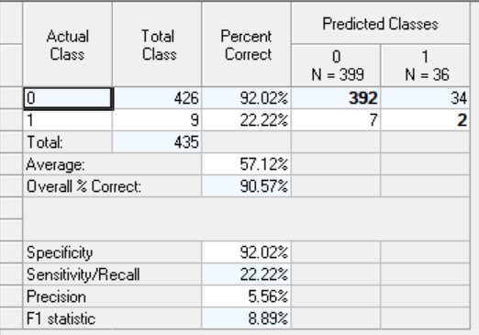
Summary Statistics (Continued)
Prediction success of the model: The result shows that model has achieved average of 57.12% prediction success rate which is relatively fine considering the size of the dataset.

Slide 26
Conclusion
The results show that the model achieved an average prediction success rate of 57.12%. This means the model has 57.12% chance of been correct in identifying a cervical patient. Which is a fairly good performance.
Also we see that out of the 16 independent attributes, there are 6 attributes that play a major role in classifying the cervical patients. These are FIRST_SEXUAL_INTERCOURSE, AGE, HORMONAL_CONTRACEPTIVES_YEARS, NUMBER_OF_SEXUAL_PARTNERS, NUM_OF_PREGNANCIES and HORMONAL_CONTRACEPTIVES.
Finally, the performance of the model can be further optimized by using combination of different algorithms and can be used by the healthcare industry, and help doctors in diagnosis of patients in getting early treatment.

Slide 27
Thank you

